Slide 1
The Missing Semester of Your CS Education
Application Architecture and Design

Slide 2
Planning Your Application
The dullest step—but the most important
An application without a plan is just a mess
While any plan will change, it important to have a general set of guidance as to how to build the pieces
Causes you to think about the potential problems within an application

Slide 3
Application Requirements
Prior to developing an application, or creating an architecture, it is important to understand the requirements
Interview business users, and understand everything they need
Develop a list of everything the application needs to be able to do, and how it needs to be able to do it

Slide 4
Functional Requirements
Business functionality that the application needs to perform
A “verb” that the application must perform
Examples:
Application must be able to accept invoices
Application must be able to generate sales reports
Users should be able to enter sales data into the application

Slide 5
Non-Functional Requirements
Attributes of “how” an application should be able to execute the the functional requirements
Describes how the application works
Examples:
Performance requirements
Stress-testing requirements
Security requirements

Slide 6
Common Application Architectures
Monolithic Architecture:
A single application handles all the business logic
All functionality for the application is one service, thus scaling the application has implications for the entire app
Any change to the application to the requires a complete rerelease of the application
Typically, these monolithic applications are updated a few times a year

Slide 7
Common Application Architectures
Microservice Architecture:
A series of smaller, more focused services are deployed
Each service handles a single piece of the business functionality
Each service can be up upgraded and scaled independently of the other services
Typically found in conjunction with containers, and a cornerstone of the DevOps philosophy

Slide 8

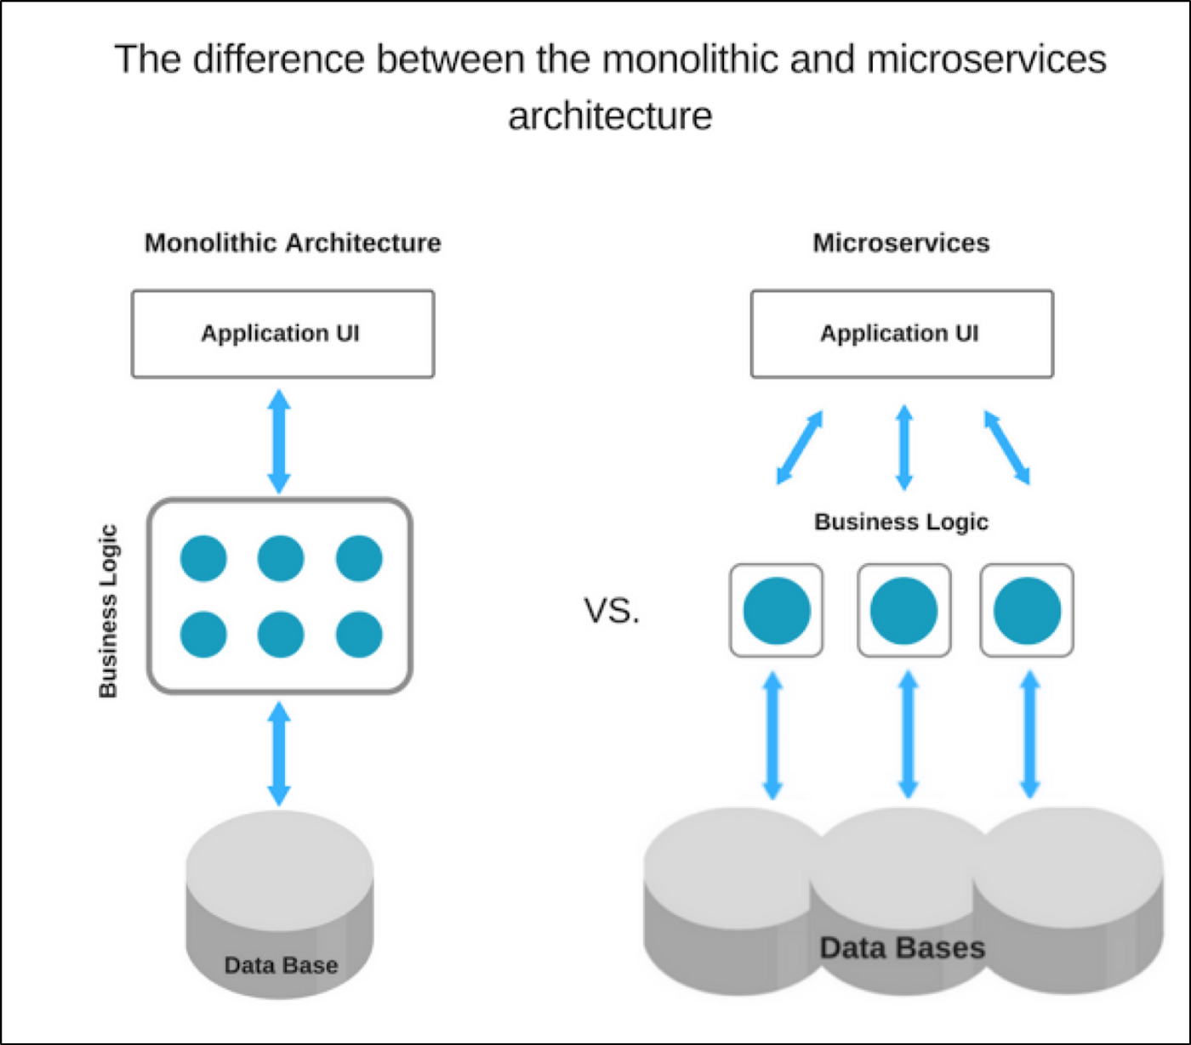
Monolith vs Microservice

Slide 9
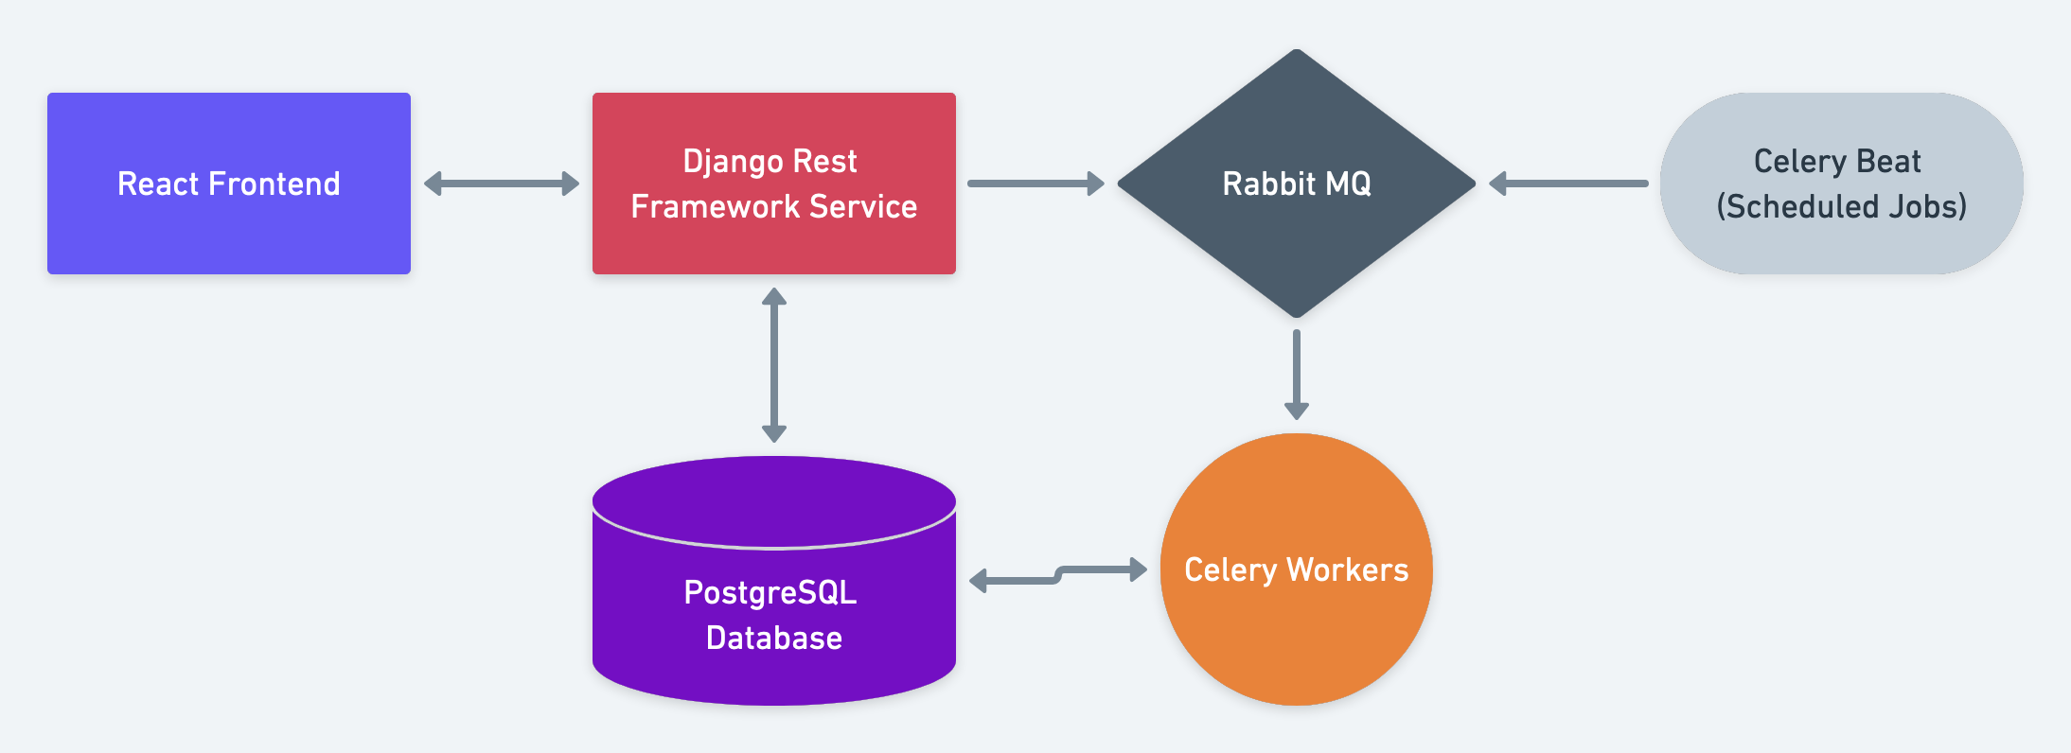
Architecture Diagrams

Slide 10
User Interface
Do you need one?
Can this be a command line only application? A simple API?
Is this a web app? A desktop app? A mobile app?
Web pages to be rendered server side or client side?
Monoliths tend to have server side rendered webpages
Microservices almost always have a client rendered web page, as they need to pull content from multiple sources

Slide 11
User Interface Frameworks– Desktop Apps
Largely dependent on what language you are using to write the client app
Java: JavaFX
Python: Tkinter
JavaScript: Electron
Often make API requests to backend services, similar to a Webapp Frontend

Slide 12



User Interfaces Frameworks - Webapps
React: ”The standard”
Angular: Often considered second best, a lot of boilerplate
Vue: An easy to learn open-source framework

Slide 13
Data Storage
Almost any application needs some form of persistent storage
A variety of ways to store this data are available
Any form of authentication requires persistent storage to store user information
Data required between runs of the application require persistent storage—typically some form of a database

Slide 14


SQL vs NoSQL
SQL: Good for structured, predictable data
NoSQL: Good for unpredictable data, typically data is stored in a JSON-like format

Slide 15
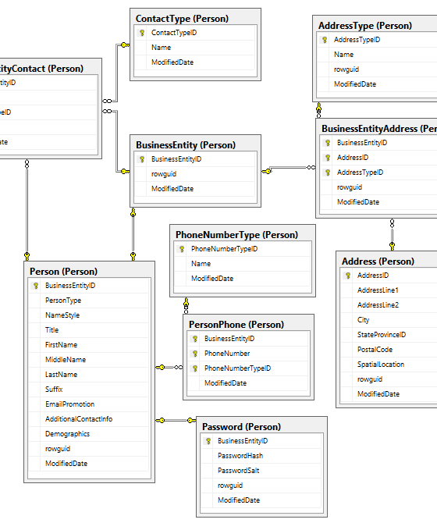
Database Diagrams
A necessity when using a SQL database
Any structured data storage requires an understanding in advance how the data will be stored
Relationships between the different data pieces must be understood in order to properly design the database

Slide 16
Long Running Tasks
Web-requests, by their nature, should only be open for a short period of time
Often, requests take more than a few seconds to execute:
Report processing
Machine Learning
These request should not be processed within the web request—often a request will time out before these processes can complete

Slide 17
Long Running Tasks
These tasks should be run in another process by another thread
Often, the web request will put the parameters for this long running task in a queue, and it will be picked up and executed by a worker process when a worker is available
This is a typical producer-consumer process flow

Slide 18
Documentation
It is always vital to document all systems, both from an end user-perspective, as well as a development perspective
Often the developers who initially write the code and design the application are not the same as those who will maintain it years later
Make life simple for yourself in the future—and whoever else maintains the code
Architecture documents, comments to the code, and written documents are all helpful for future developers

